Slide 1

Sequential Circuit Design
CMOS VLSI Circuits (19EECC301)
Conventional CMOS Latches and Flip-Flops

Slide 2
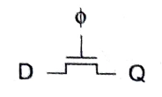
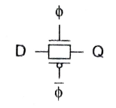
Latch Design
Pass Transistor Latch
Voltage drop of V_{t}
Output floats
Diffusion input
Output noise sensitivity
Latch Design
Transmission gate
+ No V_{t} drop
- Requires inverted clock

Slide 3
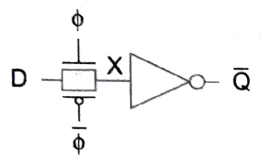
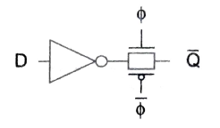
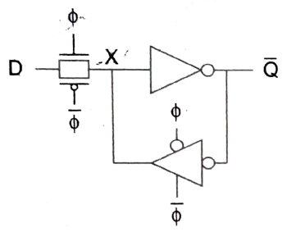
Latch Design
Inverting buffer
+ Restoring
+ No backdriving
+ Fixes either
Output noise sensitivity
Or diffusion input
– Inverted output
Latch Design
Tristate feedback
+ Static
+ Static latches are now essential

Slide 4
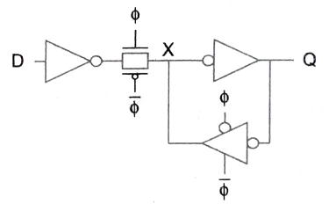
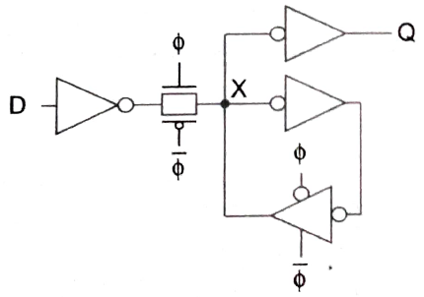
Latch Design
Buffered input
Reintroduces output noise sensitivity
Corrupts the state node X
Latch Design
Buffered output
+ static
+ No voltage drop
+ Noise sensitivity
+ Diffusion input

Slide 5
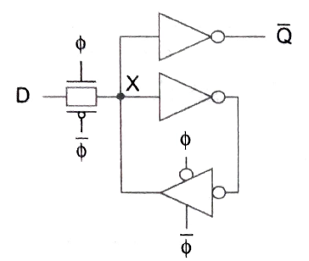
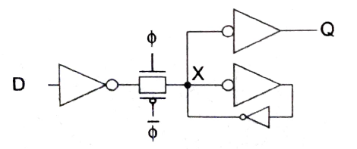
Latch Design
Datapath latch
+ faster and compact
Latch Design
Datapath latch
+ Jamb latch used in register files and FPGA cells.

Slide 6
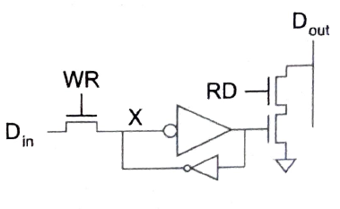
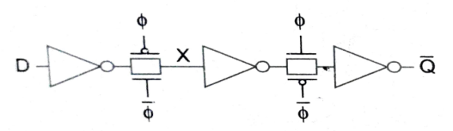
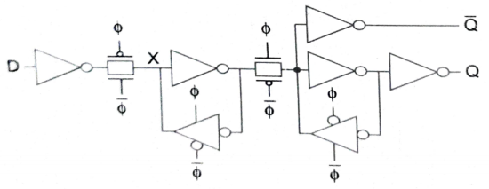
Latch Design
Datapath latch
+ Jamb latch
Flip-Flop Design
Flip-flop is built as pair of back-to-back latches

Slide 7
Thank You

